Slide 1
Administering Mongo on Windows for the Linux Programmer
by Justin Dearing – jdearing@mongodb.org
President Long Island PHP User Group
Backend Developer @Wunderman NY

Slide 2
Who is Justin Dearing
.NET/PHP developer
Former unix admin
MongoDB Community contributor

Slide 3
Background on Me
I love Mom, Applepie, and the relational model
I use mongo for my smaller projects, Postgres and Sql Server for my big ones
Notes:
I spent ~2.5 years of my life writing .NET and T-SQL code to do ETL operations on invoices data transmitted by XML, and enjoyed it. So adeptness partially explains love for SQL.
The second thing to account for my limited use of mongo is I am pretty conservative with datastores. So I like the fact that SQL is older than me

Slide 4

And BTW I use mongo on Windows

Slide 5
Pitchforks Away Please

Slide 6
So why explain mongo administration on windows to unix programmers?

Slide 7
Answer: Cross Pollination
Notes:
I've had a myriad of jobs in my “IT Career” starting with being a third shift iSeries operator, and moving through several roles eventually from operations into programming. Operating a patch system has made me a better admin of time sharing OS's. Being a sysadmin has made me a better programmer. Knowing both unix and windows has allowed me to apply “the unix tao” to windows and the better parts of windows

Slide 8
But first what do I do with mongo?

Slide 9
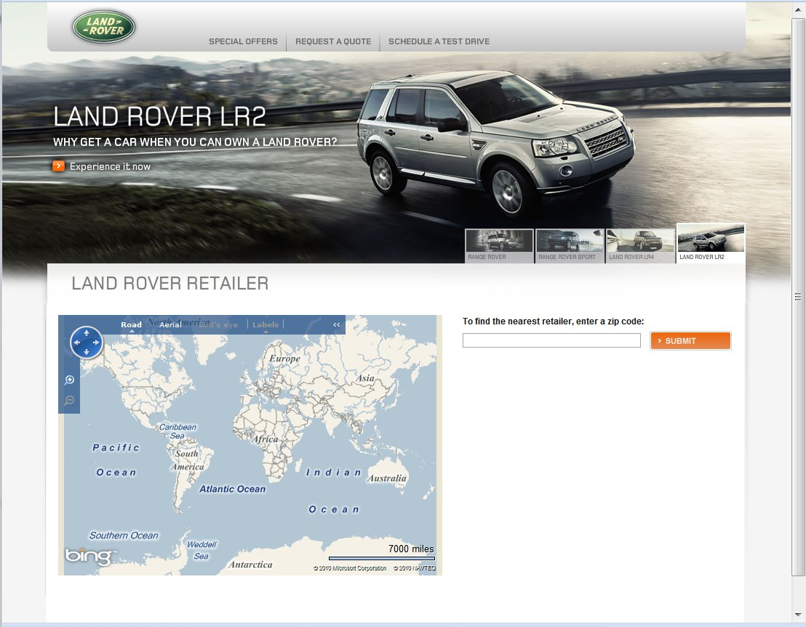
http://apps.us.landrover.com/landrover-t2/index.html#/LandRover/LR2

Slide 10
And some “write-only” stuff for Johnnie Walker

Slide 11
What Windows changes are in 1.5/1.6?

Slide 12
Windows SCM Arguments
Mongod.exe Windows Service Control Manager Arguments
--install | install mongodb service
--remove | remove mongodb service
--reinstall | reinstall mongodb service (equivilant of mongod --remove followed by mongod --install)
--service | start mongodb service
--serviceName [arg] | windows service name
--serviceUser [arg] | user name service executes as
--servicePassword [arg] | password used to authenticate serviceUser

Slide 13
Other Changes
Service related log messages
Sconstruct improvements
Continued Windows 2000 compatability

Slide 14
Installing Mongo On Windows

Slide 15
Installing
Download the zip binaries
Install to %ProgramFiles%\10gen\mongodb-ver
Add bin folder to your path
Add a mongo service user
  Remove from the users group

Slide 16
Installing (cont)
Fire up your command prompt
Type: mkdir %ProgramFiles%\10gen\mongodb-ver\data
Type: mkdir %ProgramFiles%\10gen\mongodb-ver\backup

Slide 17
Installing (cont)
Type: mongod –install –serviceUser=”mongodb” --servicePassword=”password” --dbpath=”c:\Program Files\mongodb\data” --directoryperdb
Read the verbose logs
  Fix your mistakes
  Email jdearing@mongodb.org if the messages are unclear.

Slide 18
Starting your mongo service
Reboot.
net [start|stop] mongodb
Control Panel|Administrative Tools|Services
mongod –service

Slide 19
Securing Mongo
Run mongod with –auth
  I like to do this, but network access to mongo should be isolated.
Firewall/Isolation

Slide 20
Mongo Authentication
Open a command prompt
mongo admin
db.addUser('sa', 'p@22W0rd');
db.addUser('backupOperator', 'p@22W0rd', true);
exit

Slide 21
Securing Individual Dbs
mongo admin -u sa -p [password]
use appDb;
db.system.addUser('www', 'pass', true);
db.system.addUser('www_Admin', 'pass');

Slide 22
Network Considerations
Segment your mongo server(s) on the network
Firewall your servers
  Use HARDWARE firewall
    Or a seperate linux/bsd box
  Use a DEFAULT DENY firewall ruleset

Slide 23
Backups

Slide 24
Backup strategy
2 Daily full dump backups to local disk
Backup agent backing up the live dbs and dumps
Enterprise or colo backup of local disk via filesystem agent
Backup batch file

Slide 25
TEST YOUR BACKUPS

Slide 26

Automatic Backup Test Strategies
Admins periodically restore production dbs to QA/Stage/UAT systems.
Developers restore production data to their machines.

Slide 27
When your data is too sensitive for those strategies
Manual restore to a cold-fire recovery site
Manually restore to a workstation not on the network in a secure location (locked closet in a locked office).

Slide 28
Clustering, Sharding and Redundancy
I guess that works on windows, haven't tried it.
Can supplement but not replace your backups

Slide 29
Mongosniff
Winpcap limitation: You can't sniff 127.0.0.1 on windows.
  Applies to nmap, wireshark and tcpdump too.
There is a “loopback” driver on windows. You have to assign an IP to it. Its not 127.0.0.1
Same limitations apply to tcpdump and wireshark
I never tried this

Slide 30
Administering the database
I use the command line tool mongo.exe.
Web GUI tools should work.
Same as unix basically.

Slide 31
Making mongodb better on Windows
Use it on windows
File Bugs
Participate on the mailing lists
Fix bugs

Slide 32
Where I could use help
Inform me about windows bugs you opened
SCONS/Python expertise
Feedback on error messages or lack thereof
Opinions of a real windows admin
Boost binaries for Visual Studio 6.0

Slide 33
FIN

